Slide 1
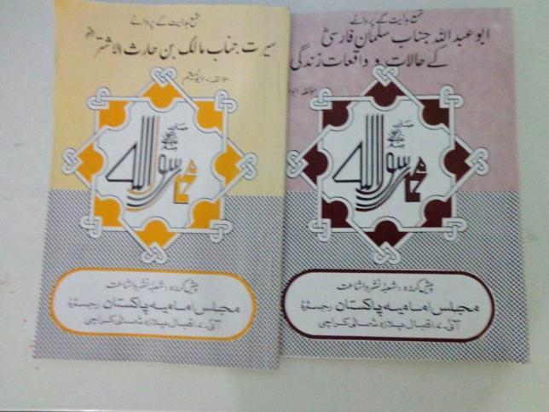
Shamaa-e-hidayat Kay Parwane
Writer: Abu Al Mesam
Publisher: Majlis e Imamia Pakistan

Slide 2
Contents:
Malik e Ashtar
Sirat e Janab e Malik-e-Ashtar
Malik-e-Ashtar ki zindagi
Malik-e-Ashtar ki khidmat
Ahed nama
Salman e Farsi
Roozbeh se Salman e Farsi tak
Janab e Salman ka ilm
Salman Farsi ki Zindagi

Slide 3
Sirat e Janab e Malik e Ashtar
Muhibbe-aal-e-Mohammad.
Roohe-Islam se waqifiiat.
Be had shujaa aur be bak.
Lashkar-e-Islam mai ehem zimme darian.

Slide 4
Sirat e Janab e Malik e Ashtar
Koofe se jalawatani
Damishq aur muawia
Koofe pe wapsi

Slide 5
Malik e Ashtar ki zindagi
Malik-e-Ashtar ka afo-o-dar guzar.
Malik-e-Ashtar ki olaad.

Slide 6
Malik e Ashtar kay khidmat
Abu Moosa Ashari ki munafiqat
Jang e Jamal
Jang e Siffin
Shahadat
Ahed nama

Slide 7
Janab e Salman e Farsi

Slide 8
Roozbeh se Salman e Farsi tak
Fars (Persia) main apka ghar.
Kalisa main ibadat.
Umooria kay rahib ki khidmat.
Yahoodi ki ghulami.
Hozoor (s.a.w.w) se mulaqaat.

Slide 9
Janab e Salman ka ilm
Awwal aur akhir ka ilm.
Askar se nafrat ka izhar.
Zameene Karbala.
Nehrwan aur koofa.

Slide 10
Salman Farsi ki Zindagi
Janab e Salman ka faqr
Salman ki shadi
Aale rasool ki nazar main
Salman Farsi ki rehlat
Salman Farsi Ka

Slide 11
Thank You !

